Slide 1




汉语课
hàn yǔ kè
2021.09.15

Slide 2

壹
贰
叁
肆
伍
CONTENTS

Slide 3
自我介绍
self-introduction
壹
Name:
Lydia （丁Ding 琪瀛Qiying）
Email:
1227499048@qq.com

Slide 4
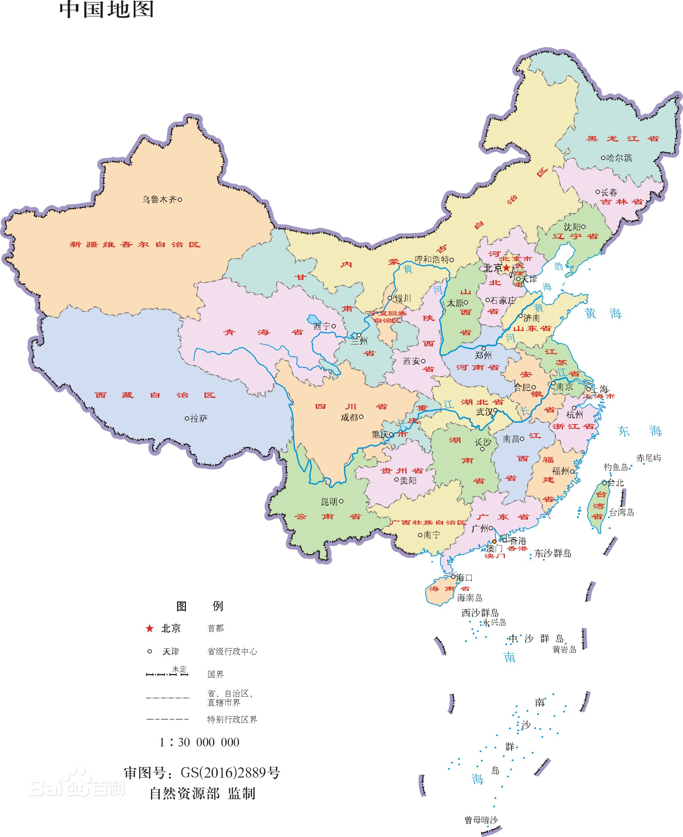

家乡（hometown）
北京Beijing
首都 Capital

Slide 5
关于课程 （about the course）
课堂展示 Presentation
1人 (do the presentation by yourself)
Theme: anything that interests you about China or Chinese culture
（Eg. Mid-Autumn Festival, hot pot, costume, custom, tradition…）
Form: PPT
Time: 10-15min
Language: English or Chinese
Send me the contents of your presentation at least 3 days in advance
From next Wednesday(9.22) one presenter for each class

Slide 6
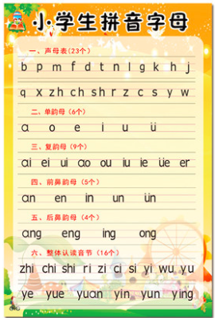
Contents
1. Review of twenty three initials (shēng mǔ) the six monofinals (dān yùn mǔ) and
2. Study of Di-finals
Appellation of your families in Chinese
New words
Conversation about greetings— “zǎo shang hǎo” (Good morning )

Slide 7
REVIEW

Slide 8
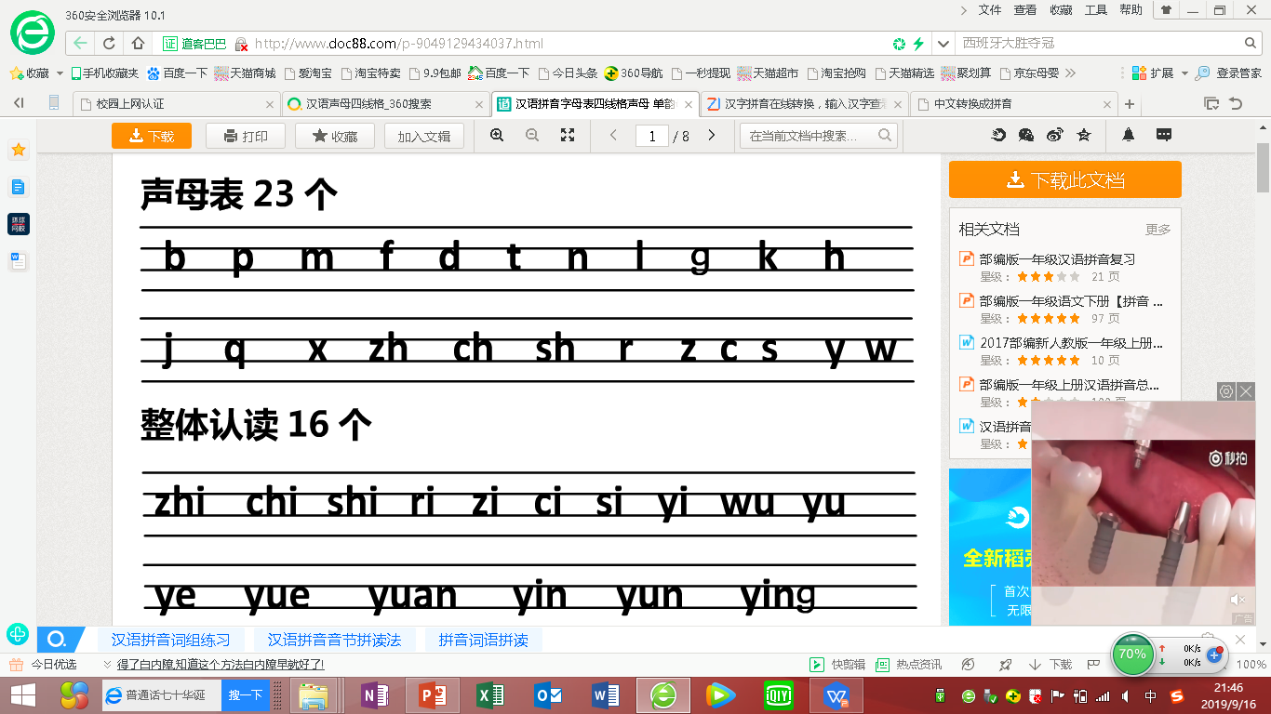
Initials
shēng mǔ
二
P73 To differentiate the finals z,c,s; zh, ch, sh; j, q and x

Slide 9
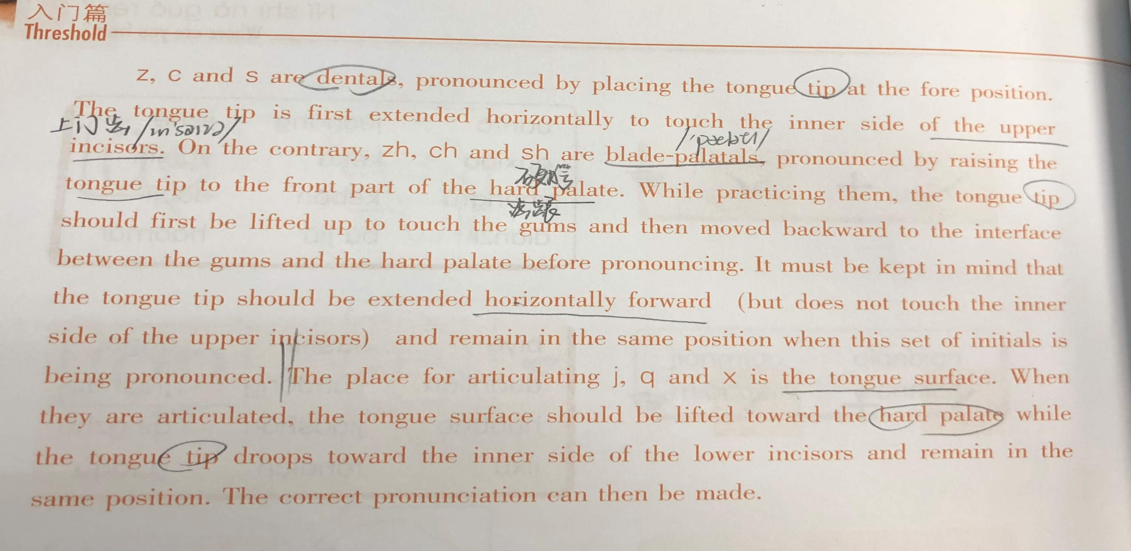

In the phonology of Mandarin Chinese, the differences among z, c, s; zh, ch, sh; j, q, x are their places of articulation.

Slide 10
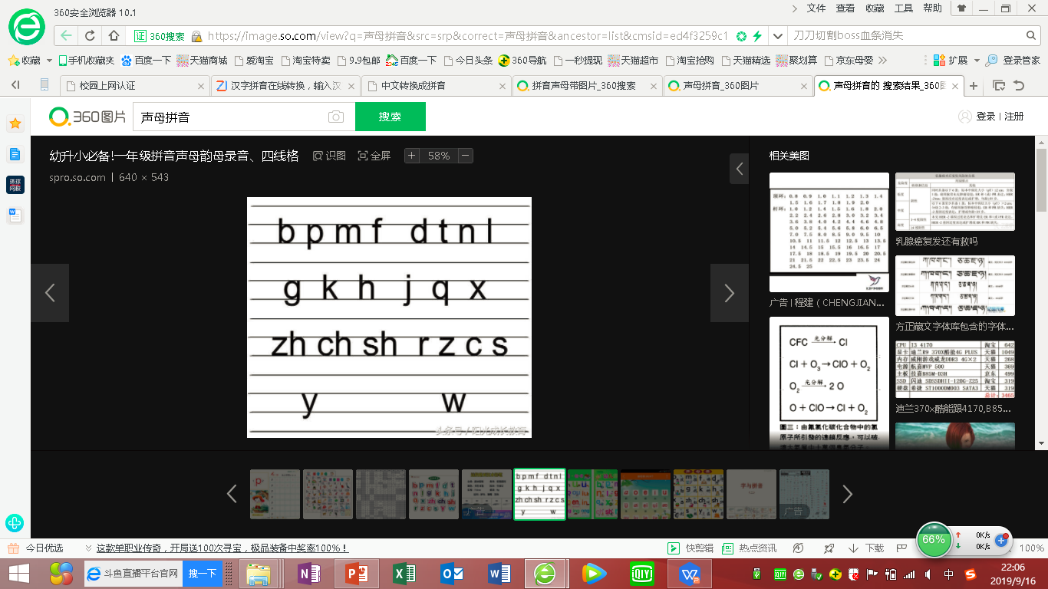
Initials
shēng mǔ
P 26-27
the foremost location in the phonology of Mandarin Chinese
b, p &m: the coordination of the upper and lower lips
f: the coordination of the upper teeth and lower lip

Slide 11
P 41-42
d vs t: d is unaspirated
t is aspirated (A strong release of breath is made when t is articulated.)
n is a nasal sound. The vocal cords should vibrate.
l: the airstream should be sent out from the two sides of the tongue and the vocal cords should vibrate.

Slide 12
Initials
shēng mǔ
P 57-58
The location is the hindmost. They are velars that are articulated by the coordination of the back part of the tongue surface and the soft palate.

Slide 13
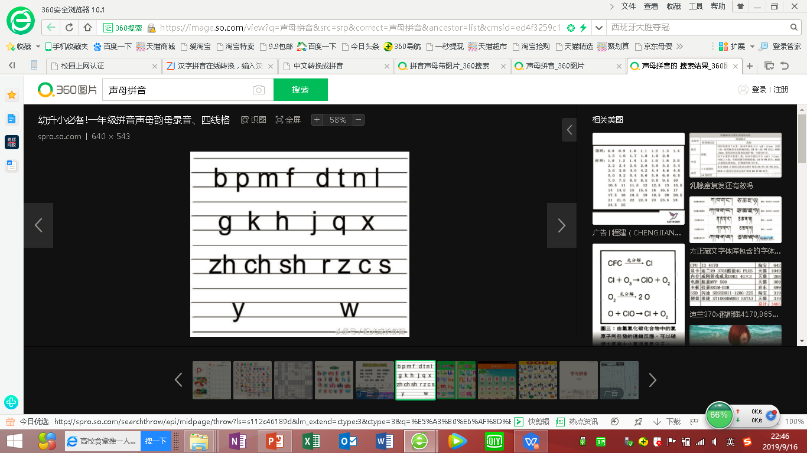
Initials
shēng mǔ
P 57-58
j & q: firstly the tongue surface is raised so that it can touch the soft palate. Then a narrow passage is opened to let the airstream go out.
j is unaspirated while q is aspirated (a strong release of breath is made)
x: the tongue surface should not touch the hard palate. There always exists a narrow passage between them

Slide 14
Initials
shēng mǔ
P 42-43
the coordination of the raised tongue tip and the front part of hard palate

Slide 15
Initials
shēng mǔ
P 27-28
the coordination between the tongue tip and the inner side of the upper incisors
z & c: the tongue tip initially makes contact with the inner side of the upper incisors before a narrow passage is opened to let the airstream go out
z vs c: z is unaspirated while c is aspirated
s: the tongue tip should not touch the inner side of the upper incisors and there always exists a narrow passage between them

Slide 16
Initials
shēng mǔ
Turn to page 7. Listen to Exercise 6. (6’’25)

Slide 17


单韵母 （dān yùn mǔ）

Slide 18
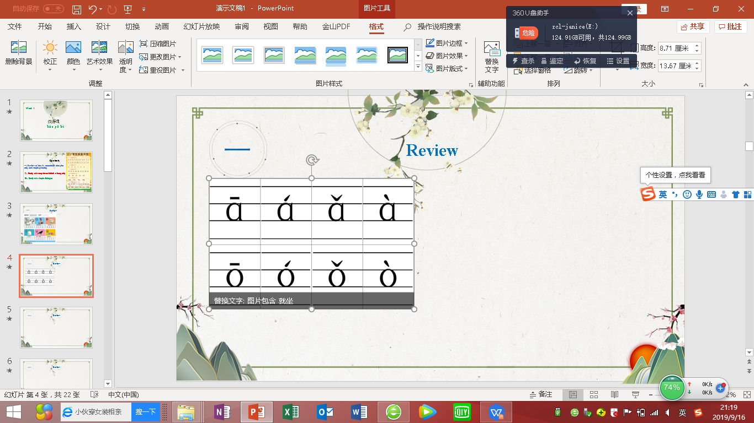
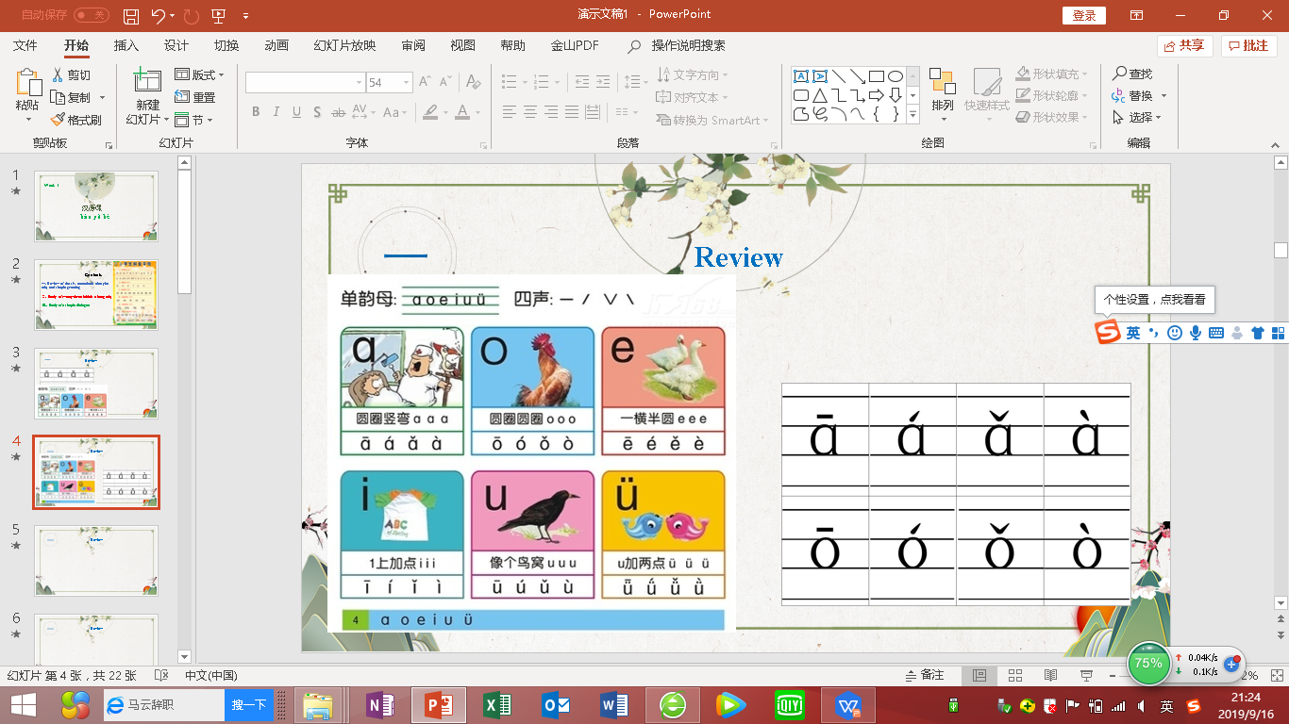
a is a round vowel.
Open your mouth and keep the air flow unobstructed.
一
Review

Slide 19
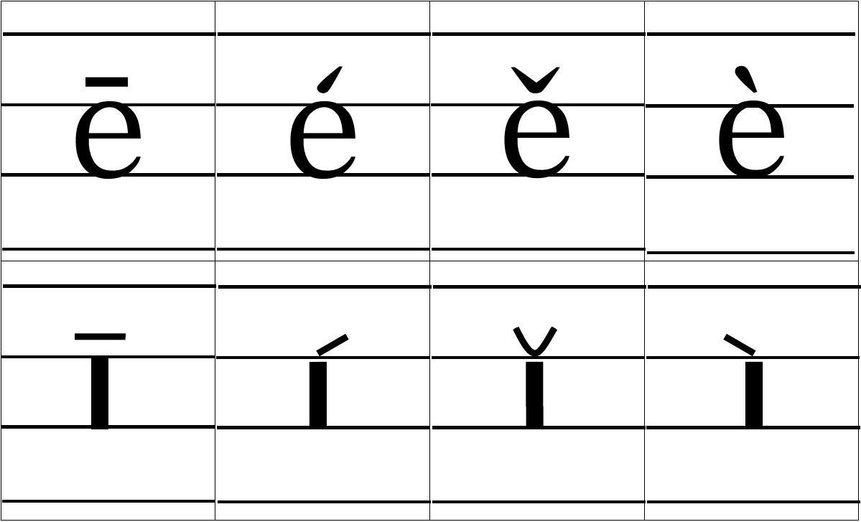
一
Review

Slide 20
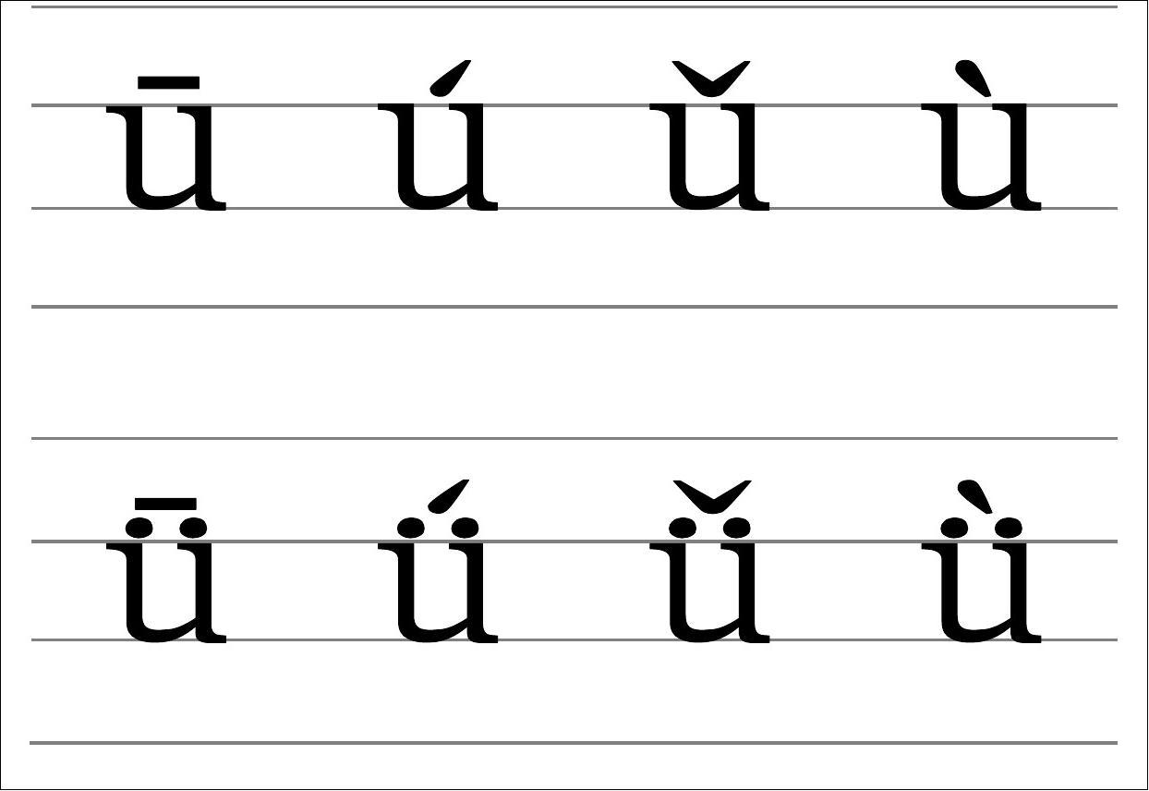
一
Review
u is a back and high round vowel. While pronouncing u, the tongue is held backward with the lips being rounded and moved forward as much as possible.
v is a front and high round vowel. If it is difficult to pronounce this sound, you can pronounce i first, and gradually transform it into v by extending the duration of i, then round up the lips while keeping the tongue position unchanged.
声调练习：p7 e5

Slide 21
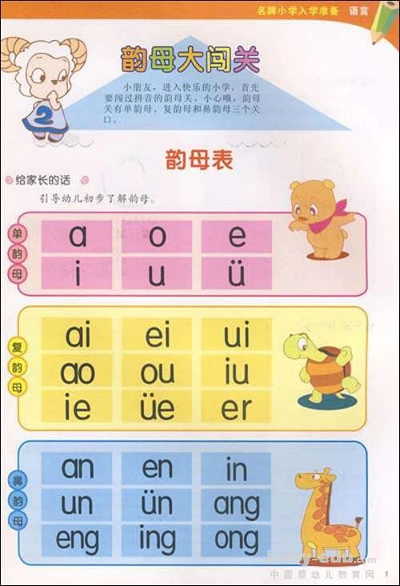
Finals 韵母
There are there types of Finals:
1. Monofinals 单韵母
2. Di-finals 复韵母
3. Nasal Finals 鼻韵母

Slide 22
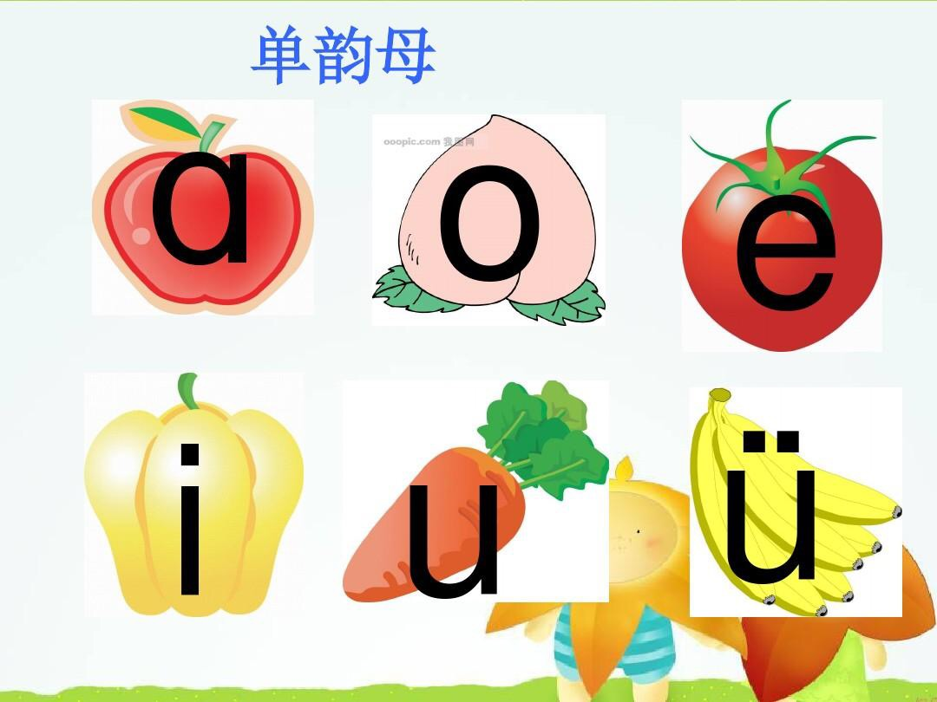
Monofinals

Slide 23

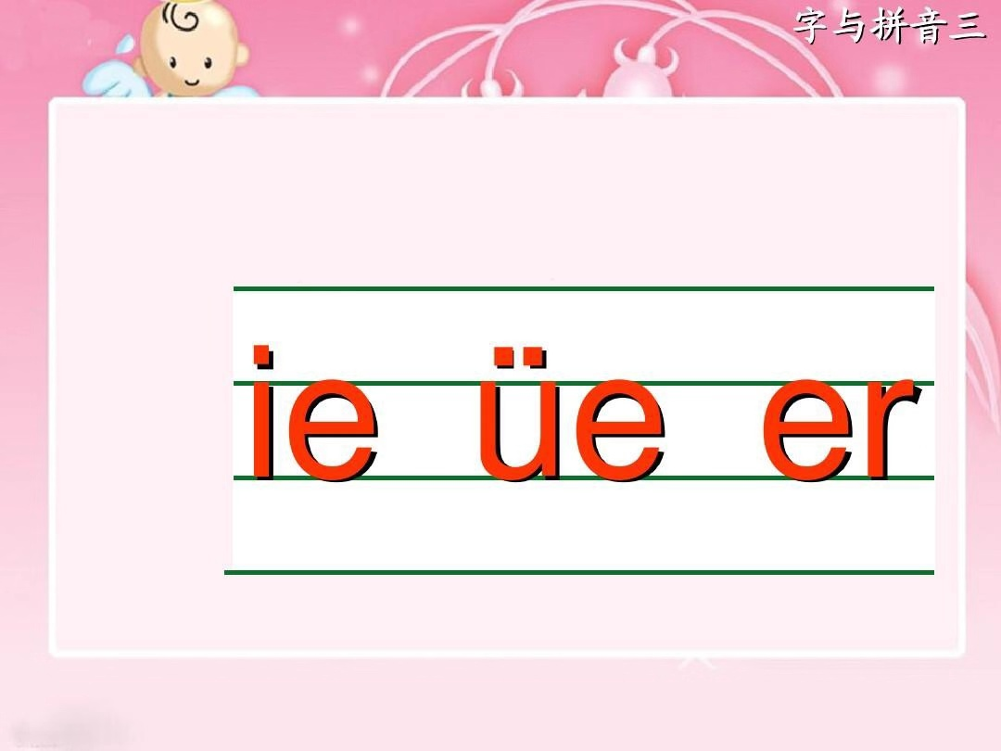
Di Finals
复韵母
(9)

Slide 24

Di Finals
复韵母

Slide 25
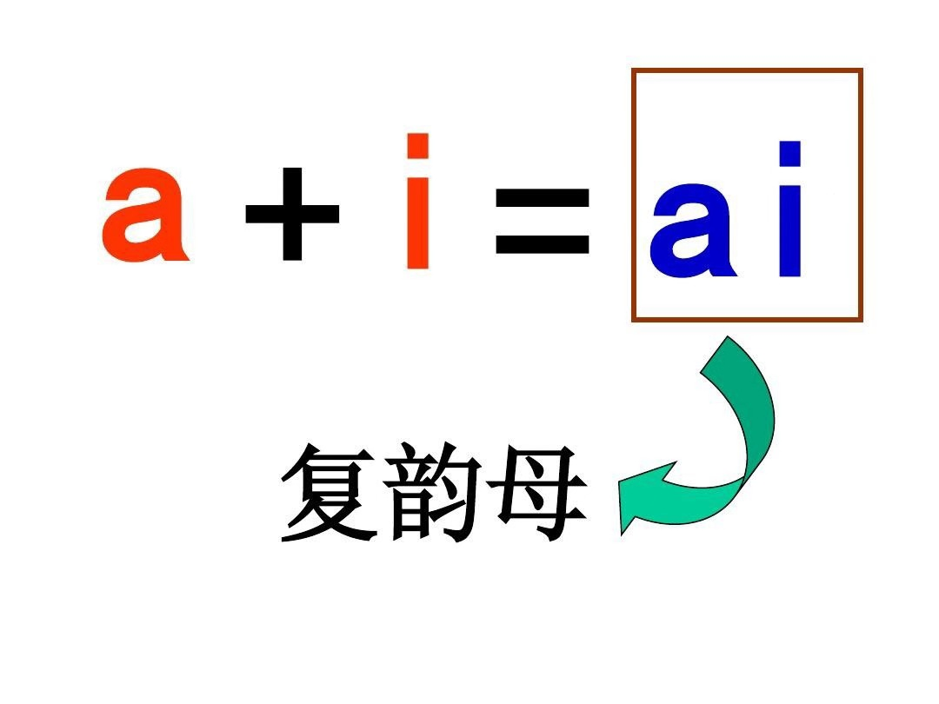

Di Finals
复韵母

Slide 26


Di Finals
复韵母
The rules about marking the tones p.29

Slide 27
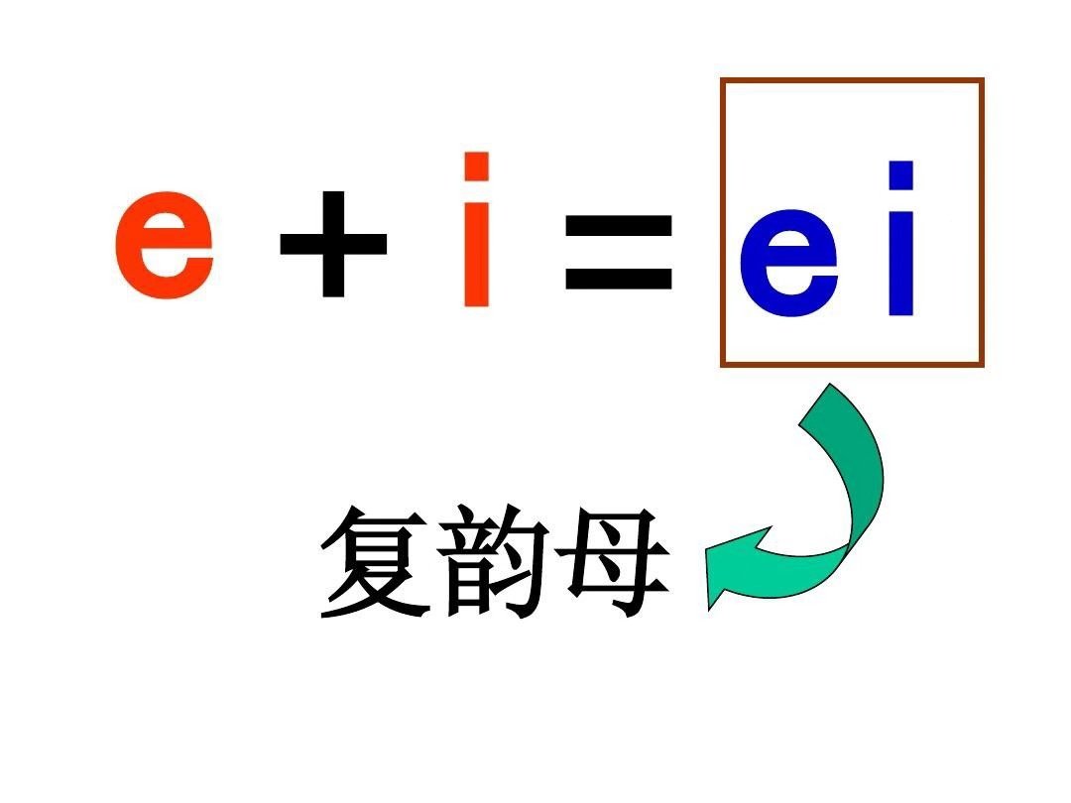
Di Finals
复韵母

Slide 28


Di Finals
复韵母

Slide 29
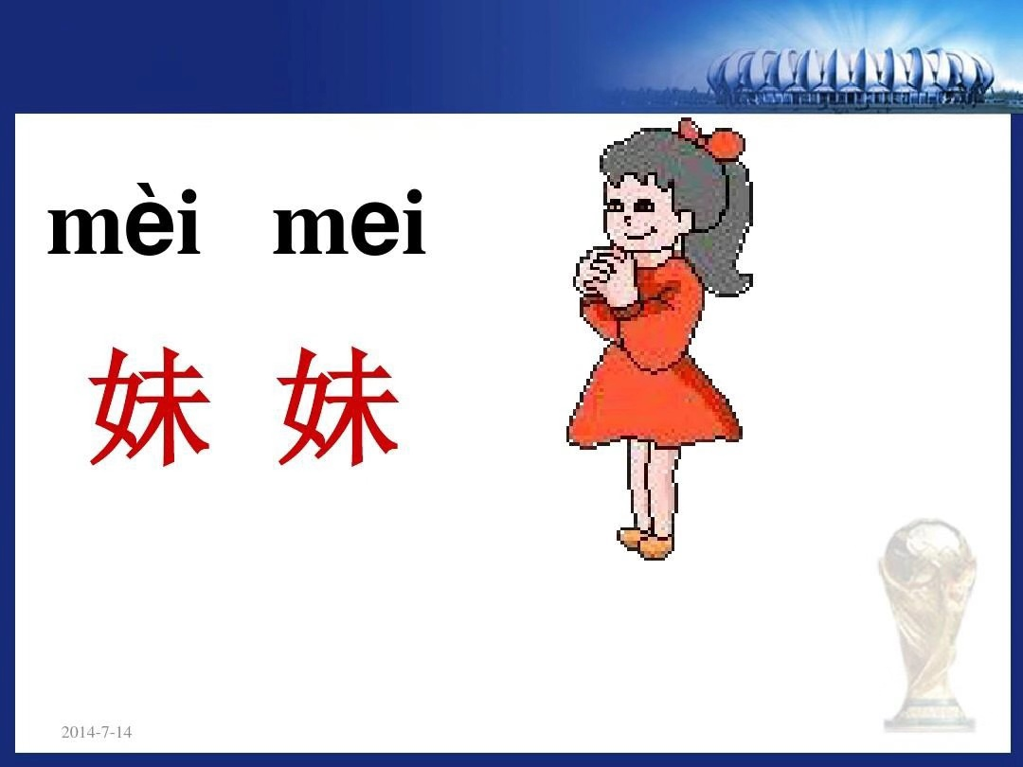

Di Finals
复韵母

Slide 30
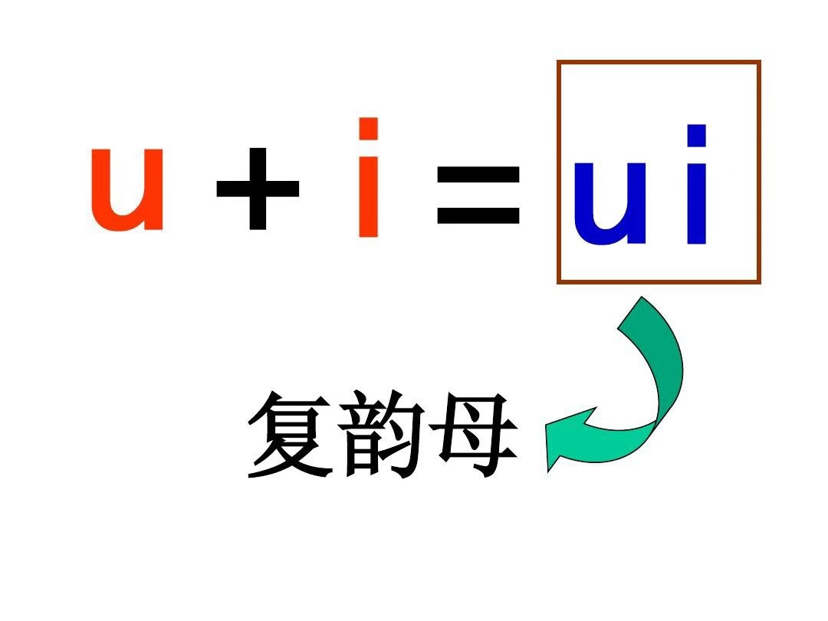
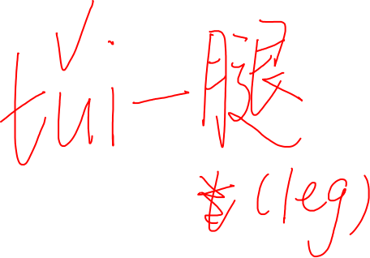
Di Finals
复韵母

Slide 32
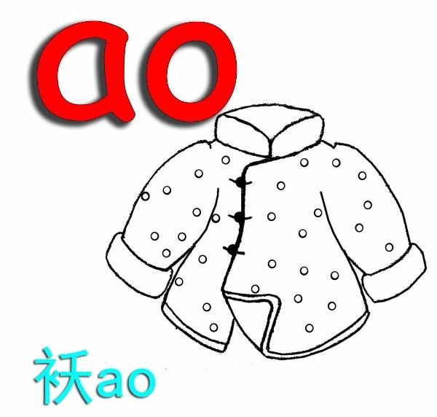
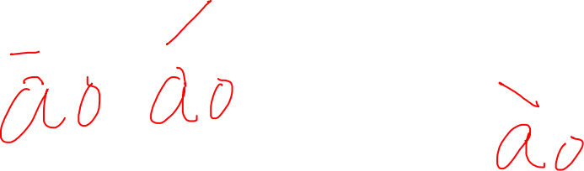

Di Finals
复韵母

Slide 33


Di Finals
复韵母

Slide 34
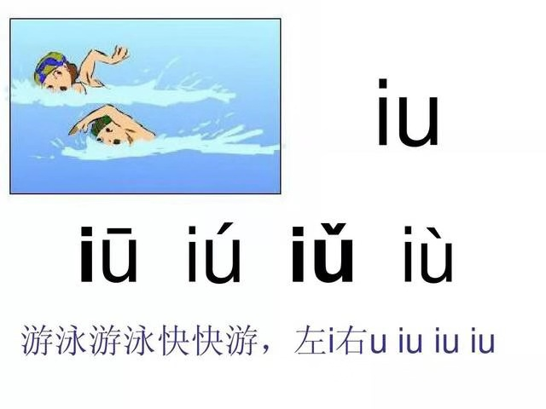
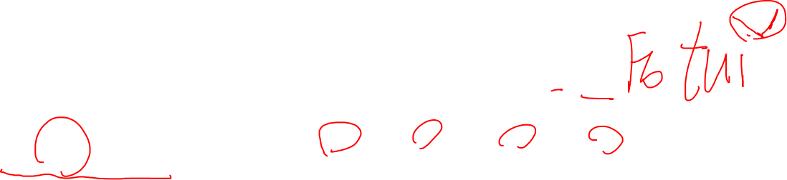
Di Finals
复韵母
Compound Finals
复韵母
the tone mark:
be labeled above
u not i p.29:5
iu
i + ou = iu

Slide 35
Page 43
When ai, ei, ao and ou are articulated, the sound of the first vowel which is the main vowel is louder and longer than that of the second one. The second vowel sounds light and short.
In addition, the mouth opens wider while pronouncing ai than ei. Similarly, the mouth also opens wider while pronouncing ao than ou.
Note that when these finals are articulated, the tongue position keeps changing in a sliding(滑动） rather than a jerking manner.
Di Finals
复韵母

Slide 37
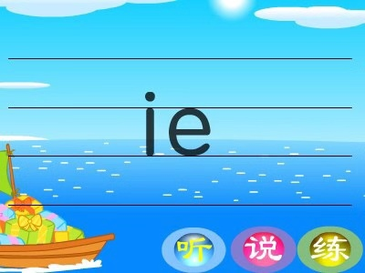
Di Finals
复韵母
ie
ye(整体认读音节）

Slide 38

Di Finals
复韵母

Slide 39
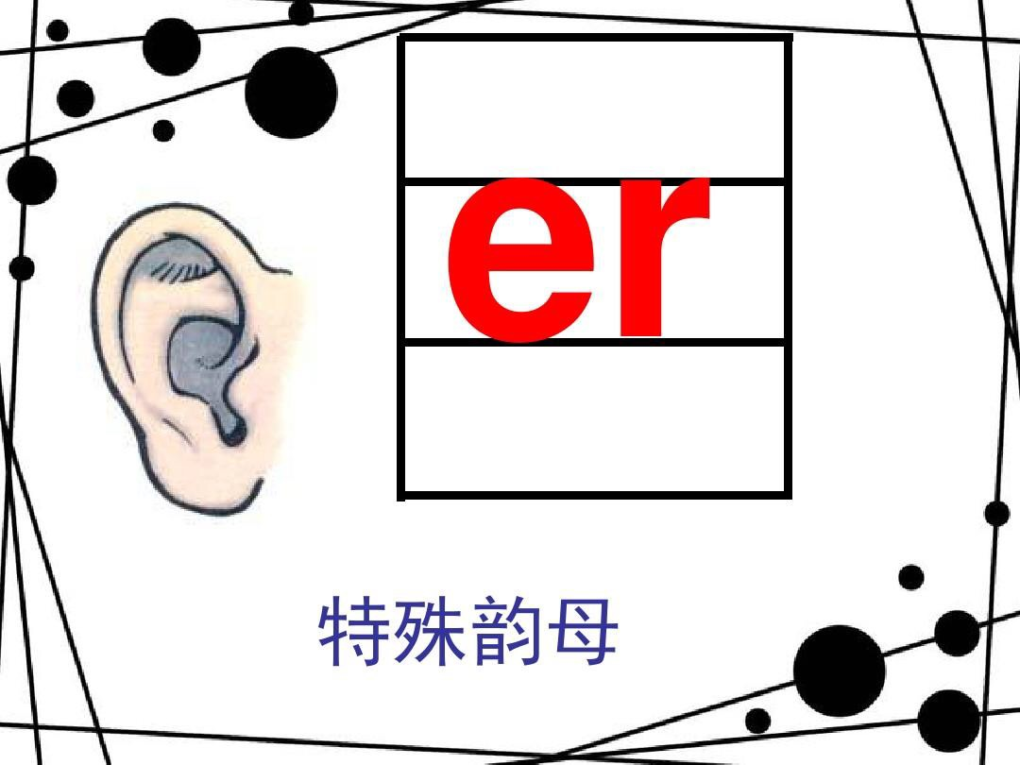


Slide 40
Di Finals
复韵母
(9)
标调：j, q, x, y后边摘帽

Slide 41
appellation of our families
二
relationship with father or mother | father (bà ba ) | mother (mā ma )
father (bà ba )爸爸 | grandpa (yé ye ) 爷爷 | grandpa (wài gōng)外公
mother (mā ma )妈妈 | grandma(nǎi nai) 奶奶 | grandma (wài pó)外婆
elder brother (gē ge) 哥哥 | uncle (bó bo) 伯伯 | (xiōng dì) 兄弟 uncle (jiù jiu) 舅舅
younger brother (dì di) 弟弟 | uncle (shū shu) 叔叔
sister (jiě mèi）姐妹 | aunt (gū gu) 姑姑 | aunt (ā yí) 阿姨

Slide 42
brother (xiōng dì ) 兄弟 | elder brother (gē ge) 哥哥
 | younger brother (dì di) 弟弟
sister (jiě mèi) 姐妹 | elder sister (jiě jie) 姐姐
 | younger sister (mèi mei) 妹妹
For example, we call our elder brother gē ge 哥哥
our younger brother (dì di) 弟弟
our elder sister (jiě jie) 姐姐
our younger sister (mèi mei) 妹妹
(xiōng dì) 兄弟 refers to both our elder and younger brothers
(jiě mèi) 姐妹 refers to both our elder and younger sisters

Slide 43
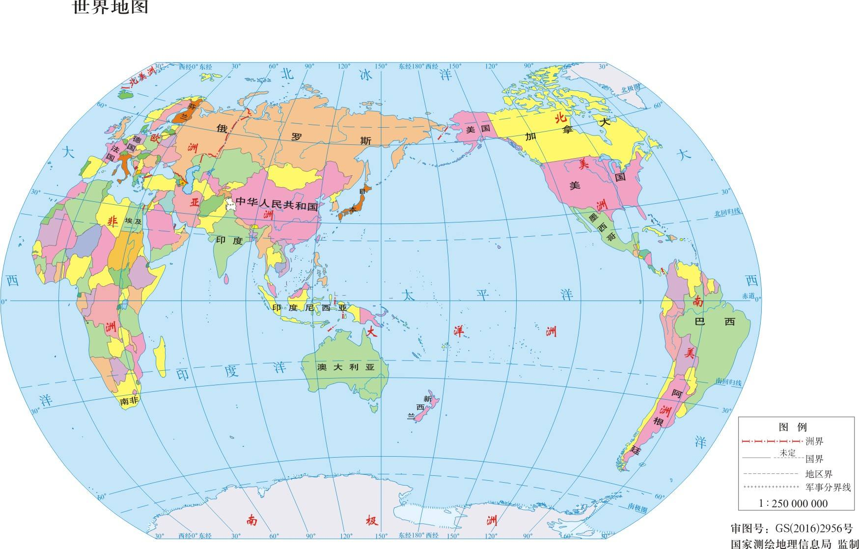
New Words（p4)
dì tú 地 图

Slide 44
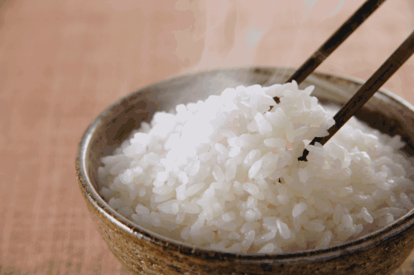
New Words
mǐ fàn 米 饭

Slide 45
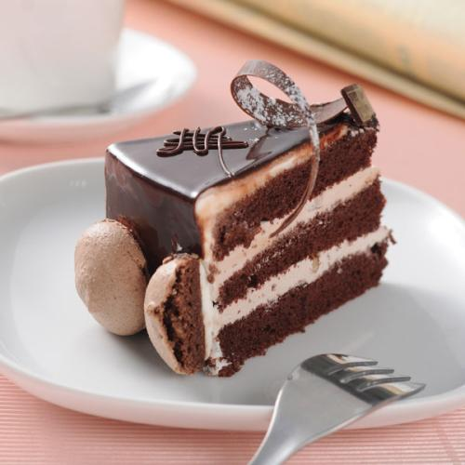
New Words
dàn gāo
蛋 糕

Slide 46
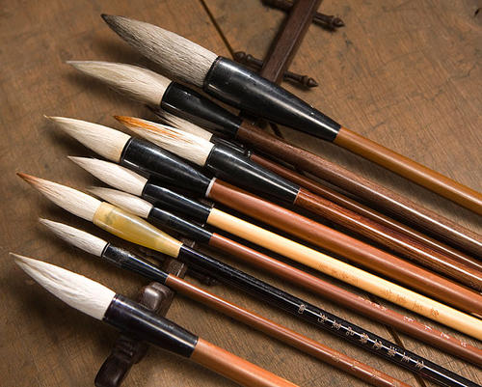
New Words
máo bǐ 毛 笔

Slide 47
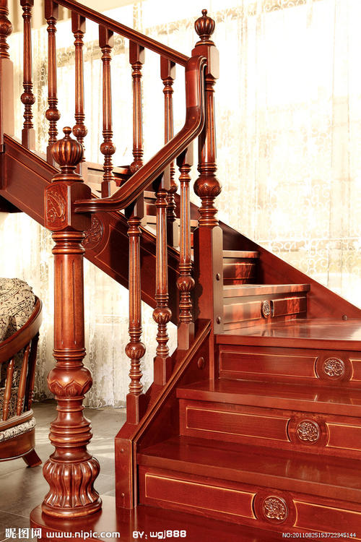
New Words
lóu tī 楼 梯

Slide 48

New Words
yǔ yī 雨 衣

Slide 49
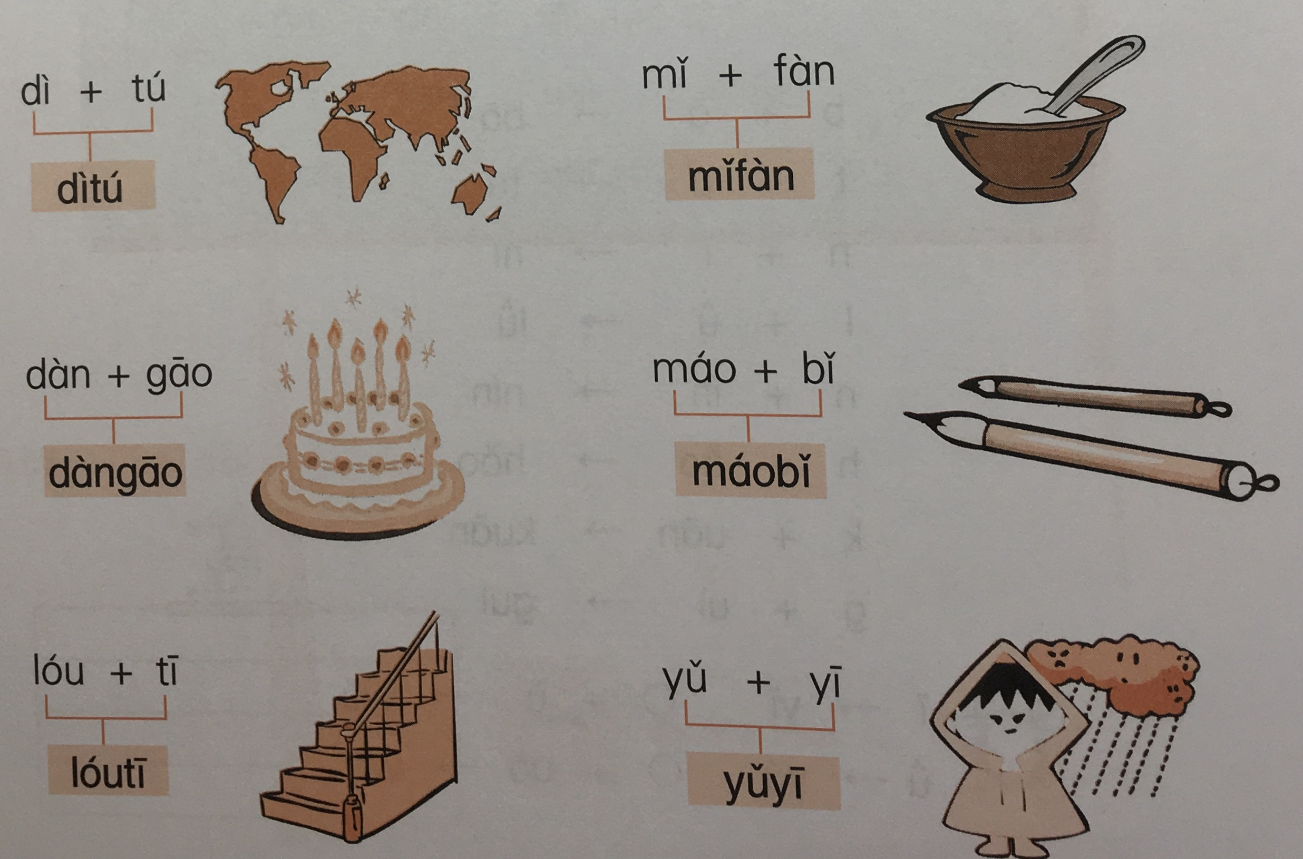
We'll have five minutes to remember these phrases.

Slide 50
quiz
cake
rice
map
stair
raincoat
Chinese Calligraphy Brush Pen

Slide 51
shù zì 数 字 numbers
数字 Number | 汉语 Chinese | 英语 English
yī | 1; 一 | one
èr | 2; 二 | two
sān | 3；三 | three
sì | 4；四 | four
wǔ | 5；五 | five
liù | 6；六 | six
qī | 7；七 | seven
bā | 8；八 | eight
jiǔ | 9；九 | nine
shí | 10；十 | ten

Slide 52
第一课(Unit 1)
How do you do?/ Hi!
你好
第二课(Unit 2)
zǎo shang hǎo!
早 上 好!
Good morning!

Slide 53
三
TEXT
A: Nǐ hǎo ma ?
(How are you?)
Hěn hǎo
B: Hái kě yǐ
Bù hǎo
nǐ hǎo
nǐ men hǎo

Slide 54
key words
phrase | Chinese | English
zǎo shang hao | 早上好 | Good morning
Ni shēn tǐ | 身体 | health
zěn me yàng | 怎么样 | how
hěn | 很 | very
xiè xie | 谢谢 | thanks
lǎo shī hao | 老师好 | Hello teacher

Slide 55
1. key words
phrase | Chinese | English
zhè/zhèi | 这 | this
shì | 是 | be
jiào | 叫 | name (v.)
fǎ guó | 法国 | France
rén | 人 | people
huān yíng | 欢迎 | welcome

Slide 56
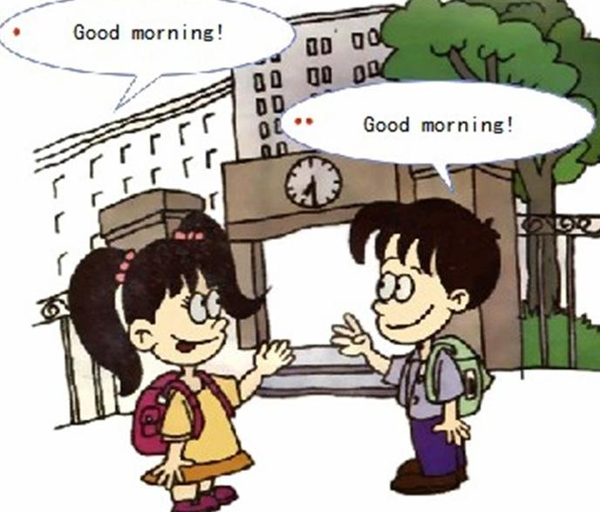
2. text 1
A：Good morning!
B：Good morning!
A：How are you?
B：Fine. Thanks!

Slide 57
2. text 1
A：Zǎoshang hǎo！
（ Good morning!）
B：Zǎoshang hǎo！
（Good morning!）
A：Nǐ shēntǐ zěnmeyàng?
（How are you?）
B：Hěn hǎo. Xiè xie!
（Very good/Fine. Thanks!）
A: recently/Zuì jìn zěn me yàng?
B: Hěn hǎo./very good
Hái kě yǐ!/not bad
bù tài hǎo/ not very good/ bù hǎo /not good

Slide 58

2. text 2
A: Mr. Wang, this is Oven.
B: Hello! I'm Oven, from France.
C: Hello! Welcome!
B: Thank you!

Slide 59
2. text 2
A：Wáng lǎo shī, zhè shì Ōu wén.
（Mr. Wang, this is Oven.）
B：Nín hǎo! Wǒ jiào Ōu wén, shì Fǎ guó rén.
（ Hello! I'm Oven, from France.）
C：Nǐ hǎo! Huān yíng nǐ./you
（Hello! Welcome!）
B：Xiè xie！
（Thank you!）

Slide 60

Thank you！
PPT模板下载：www.1ppt.com/moban/ 行业PPT模板：www.1ppt.com/hangye/
节日PPT模板：www.1ppt.com/jieri/ PPT素材下载：www.1ppt.com/sucai/
PPT背景图片：www.1ppt.com/beijing/ PPT图表下载：www.1ppt.com/tubiao/
优秀PPT下载：www.1ppt.com/xiazai/ PPT教程： www.1ppt.com/powerpoint/
Word教程： www.1ppt.com/word/ Excel教程：www.1ppt.com/excel/
资料下载：www.1ppt.com/ziliao/ PPT课件下载：www.1ppt.com/kejian/
范文下载：www.1ppt.com/fanwen/ 试卷下载：www.1ppt.com/shiti/
教案下载：www.1ppt.com/jiaoan/
字体下载：www.1ppt.com/ziti/

